Slide 1
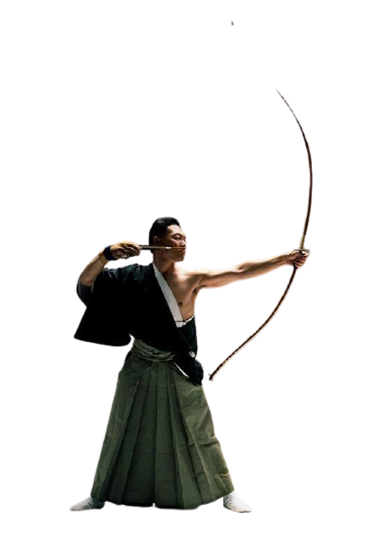
WSKF Syllabus
To 7th kyu and 6th kyu
Kihon
FROM ZENKUTSU DACHI GEDAN BARAI
1.↑ CHUDAN OI-ZUKI
2.↑ CHUDAN GYAKU-ZUKI
3.↓ JODAN AGEUKE - GYAKUZUKI
4.↑ CHUDAN SOTOUKE - GYAKUZUKI
5.↓ CHUDAN UCHIUKE - GYAKUZUKI
FROM KOKUTSU DACHI
6.↑ CHUDAN SHUTO UKE
FROM ZENKUTSU DACHI
7.↑ MAEGERI
8.↑ MAWASHIGERI
9.↑ YOKOGERI KEAGE
10.↑ YOKOGERI KEKOMI
Kata
TAIKYOKU SHODAN
HEIAN SHODAN
HEIAN NIDAN
HEIAN SANDAN
Kumite
KIHON-GOHON-KUMITE
KIHON-SANBON-KUMITE
KIHON-IPPON-KUMITE

Slide 2
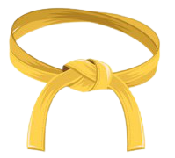
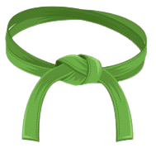
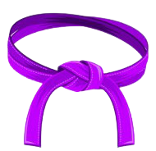
WSKF Syllabus
To 7th kyu and 6th kyu
WSKF Syllabus
To 5th kyu and 4th kyu

